Slide 1
Chapter 7. Event study
Financial Econometrics
Department of financial engineering
Zhongnan university of economics and law
Xu Yonghao

Slide 2
oUTLINE
Introduction
No Control Group
With Control Group
EMH & Behavior Finance

Slide 3
1 event study Introduction
The procedure of event study
Define the event
Data collection
Estimate raw and abnormal (adjusted) return
Statistical test and/or regression analysis

Slide 4
1.1 Define the event
What event and when? Notes when defining events :
If the events are of the same kind, the direction of market reaction should be considered.
For example, in M&A research, the reactions of the acquirer and the acquiree may be different, so we should only look at the acquirer (or the acquiree).
Analysts' reports, which have been revised up and down, should be separated.
The change of events relative to the stock market price is exogenous;
Whether the event affects the stock price or triggers the event.
Announcement of abnormal fluctuation of stock price?
Stock price trigger event, Or the other way around?
CEO turnover? Either direction is possible
For endogenous event, can we do event study?
Yes and no, because the explanation is different. The result shows correlation, not causality.

Slide 5
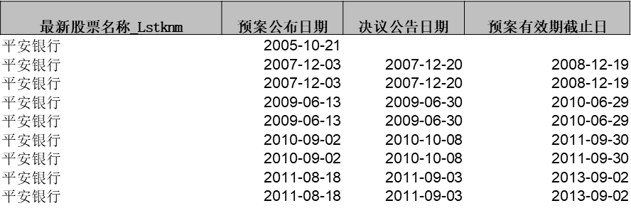
1.1 Define the event
Event Date：1. The time when the event happens; 2. The event known by the market.
“预案公布日期”（可能还有董事会会议日期）可以是事件的时间。它们对应的事件主要考察是“市场猜公司为什么增发”
“决议公告日期”也可以是事件的时间。它们对应的事件主要“预案公告是有部分人没注意到，从而还有信息含量”
“预案有效截止日”对应的事件是“增发导致市场的流动性变化”
大部分研究关注的是事件为什么发生，即市场知道的时间，这里就是“预案公布日期”
Event Window
Because of possible information leak, event window usually starts at –5, (-5, 10)

Slide 6
1.1 Define the event
A single event
All firms are impacted by the event.
A selected group of firms are impacted by the event.
A random group of firms are impacted by the event.

Slide 7
1.2 collecting data
Data needed:
-- event date
-- returns
-- factors will be used to estimate normal return
-- fundamental information of all firms

Slide 8
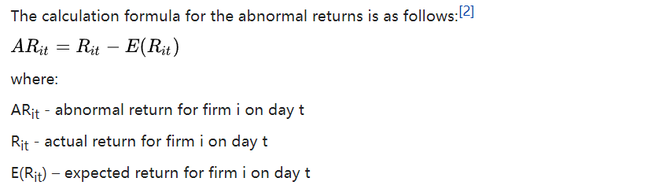
1.3 abnormal return estimation
Cumulative abnormal return, or CAR, is the sum of all abnormal returns.

Slide 9

1.3 abnormal return estimation
Cumulative abnormal return(CAR)
is the sum of all abnormal returns.
2. Buy-and-hold abnormal return (BHAR)
The BHAR is based on this principle and calculates abnormal returns by deducting the normal buy-and-hold return from the realized buy-and-hold return.

Slide 10
1.3 abnormal return estimation
Model used for normal return estimation （factor model）:
-- constant mean return
-- market model
-- Fama-French 3 factor model
-- extended 3 factor model, adding momentum factor
-- market-adjusted model
-- size-industry portfolio adjusted model
Data used to estimate normal return:
-- Event window and estimation window cannot overlap
-- Estimation window usually ends at –10 because of possible information leak.
-- The length of estimation window?
-- enough to estimate the normal return model.
-- around 200

Slide 11
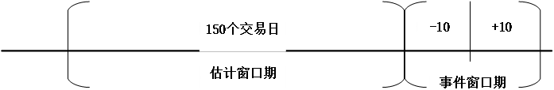
1.3 abnormal return estimation
By stock level, OLS regression.
Regress the FF3 model for each firm.

Slide 12
1.4 Statistical test and regression
Whether there is abnormal return: t-test the calculated abnormal return at each time point directly
One day abnormal return
if there is significant abnormal return on - 3 days, it means that:
Information leaked in advance
There is a problem with the event date you defined
If there is significant abnormal return on day + 2 and the response is consistent with that on day 0, it means that:
Lag reaction
If there is a significant abnormal return on day + T, which is opposite to the reaction on day 0, it means that:
Reversal reactionThe previous reaction was “noise” or sentimental factors
Testing and drawing picture of accumulated abnormal income

Slide 13
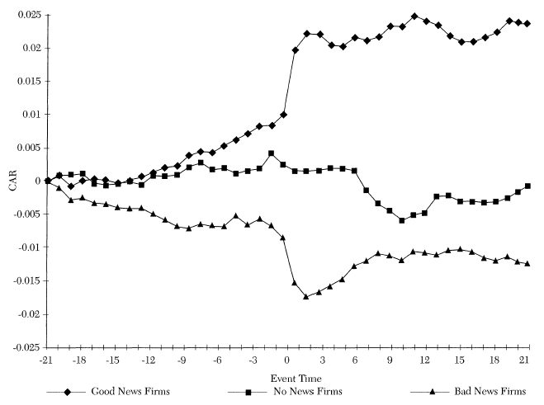
1.4 Statistical test and regression

Slide 14
1.4 Statistical test and regression
The limitation of t test.
correlation of AR should not exist
Macro event:
i.e., interest rate change of central bank
Only correlation
Overlapping problem of different event date.
What if events happens in the consecutive days？
Causing correlation of AR between different event dates.
Bootstrapping
pseudo-portfolio
Regression models(Fama-Macbeth regression; DID)
Explore and eliminate other factors that affects AR.
T test first, then comes other tests.

Slide 15
2 Market Wide Event
All firms are affected by one market wide event.
Therefore, there are no treated groups and control groups.
The endogeneity are generally considered unsolvable in this case.
Unless the events themselves are exogenous.
Therefore, mechanism analysis is important.

Slide 16
2 Market Wide Event
1. Analysis based On Market Index
2. Analysis based On Industry Index
3. Analysis based On Stock Return
T test.
Regression.
邹文理,王曦,谢小平.中央银行沟通的金融市场响应——基于股票市场的事件研究[J].金融研究,2020(02):34-50.
Kaplanski G, Levy H. Sentiment and stock prices: The case of aviation disasters[J]. Journal of financial economics, 2010, 95(2): 174-201.
Liu L X, Shu H, Wei K C J. The impacts of political uncertainty on asset prices: Evidence from the Bo scandal in China[J]. Journal of financial economics, 2017, 125(2): 286-310.

Slide 17
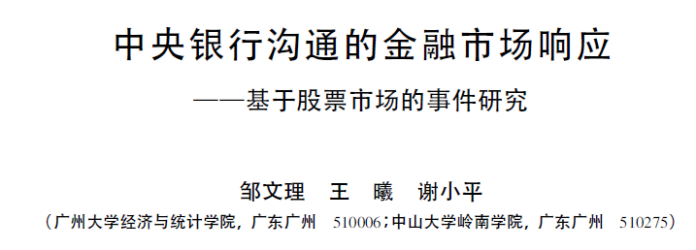
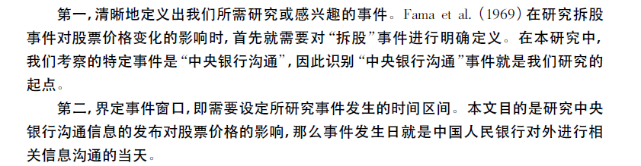
2.1 Industry Level analysis

Slide 18
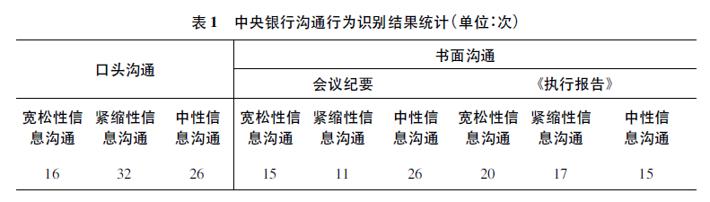
2.1.1 Event Category

Slide 19
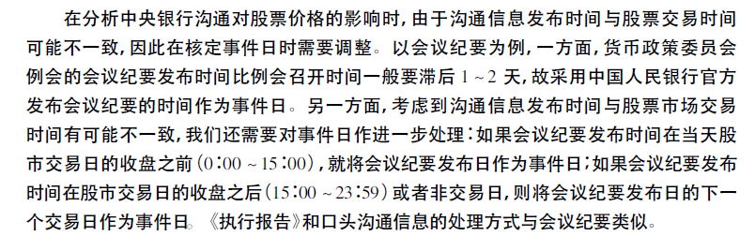
2.1.2 Market Wide Event - TIME

Slide 20
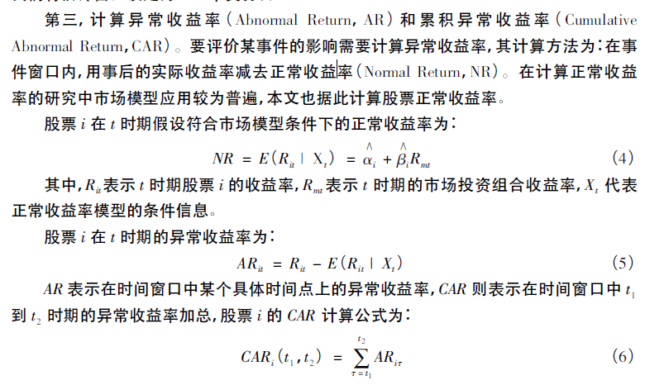
2.1.3 Market Wide Event – AR and CAR

Slide 21
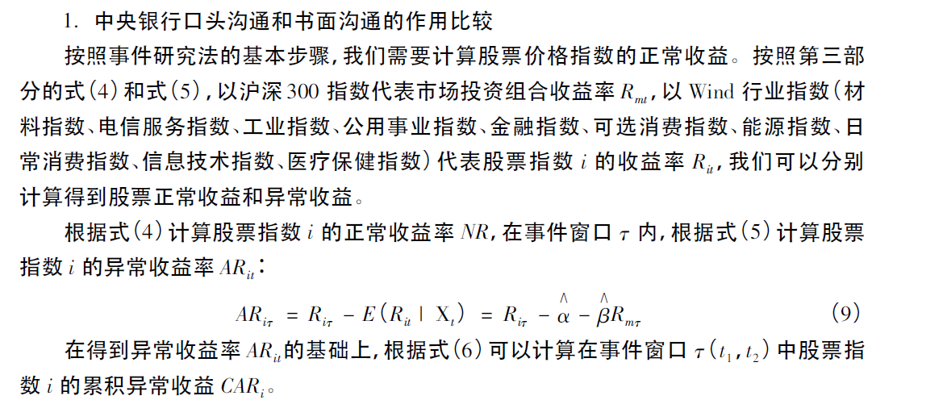
2.1.3 Market Wide Event – AR and CAR

Slide 22
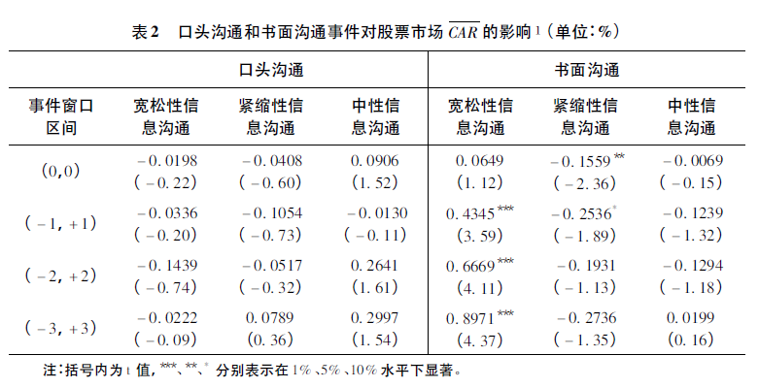
2.1.3 Market Wide Event – AR and CAR

Slide 23
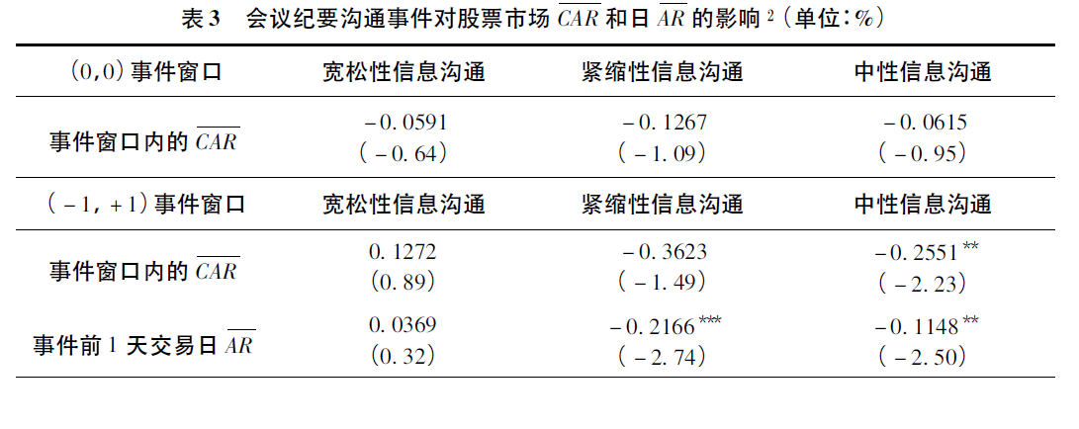
2.1.3 Market Wide Event – AR and CAR

Slide 24
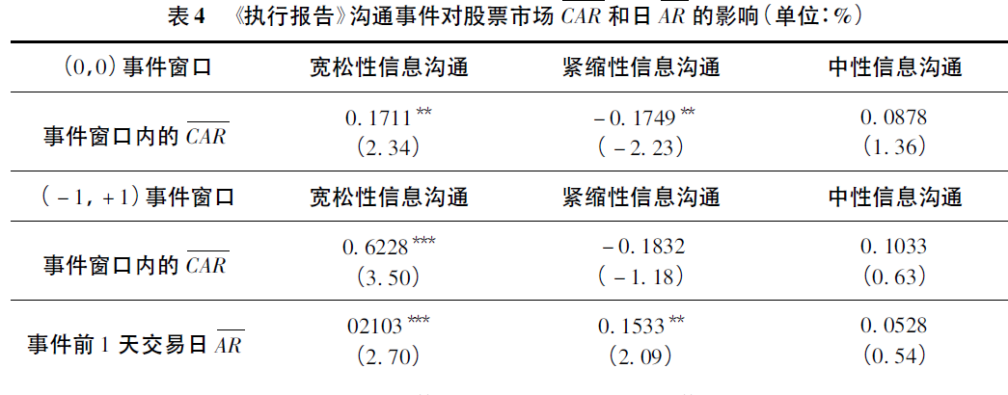
2.1.3 Market Wide Event – AR and CAR

Slide 25
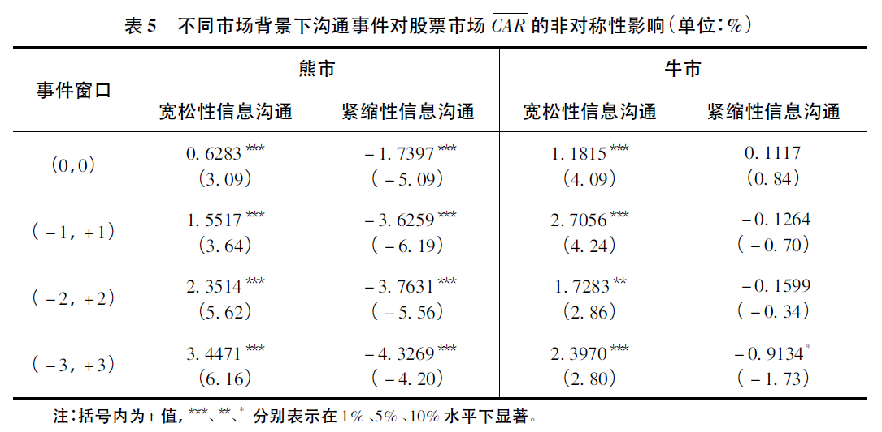
2.1.4 Market Wide Event - Hete

Slide 26
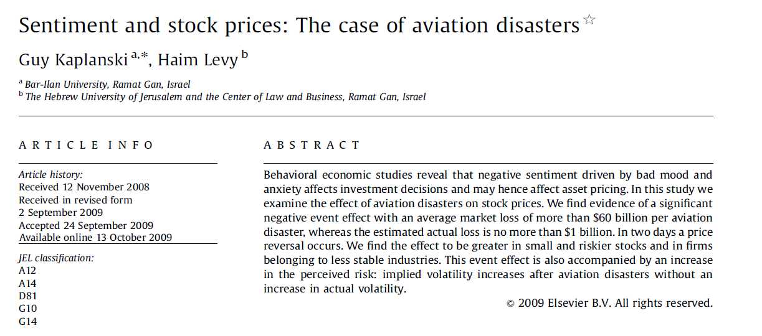
2.2 Market level analysis

Slide 27
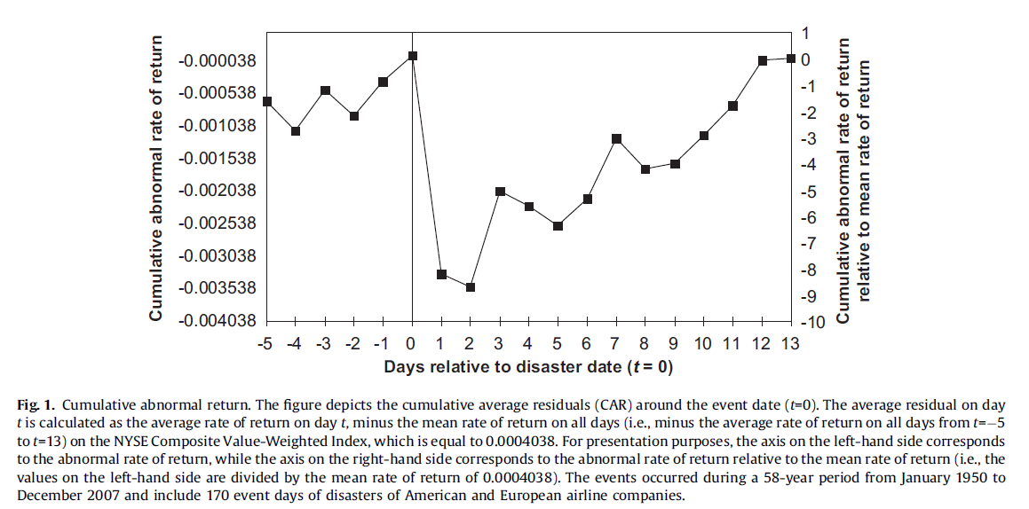
2.2.1 Market level analysis - Graphics

Slide 28
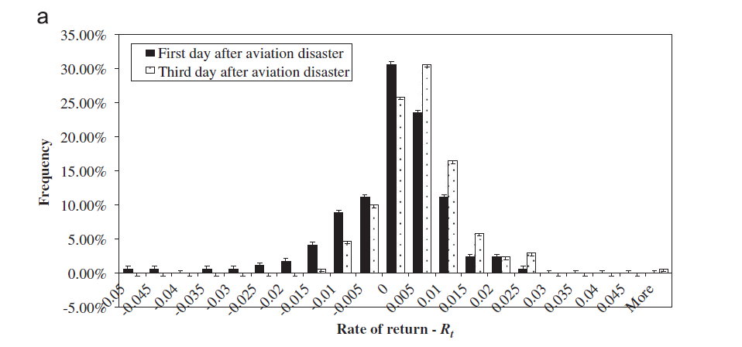
2.2.1 Market level analysis - Graphics

Slide 29
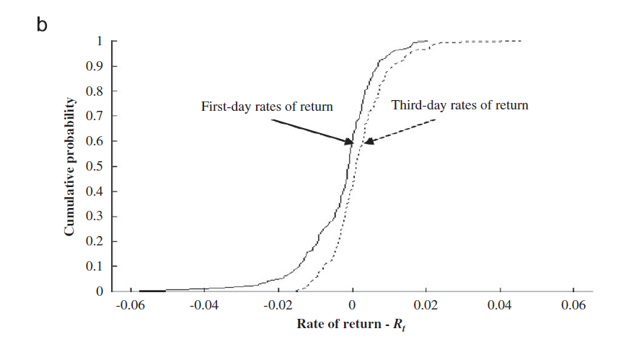
2.2.1 Market level analysis - Graphics

Slide 30
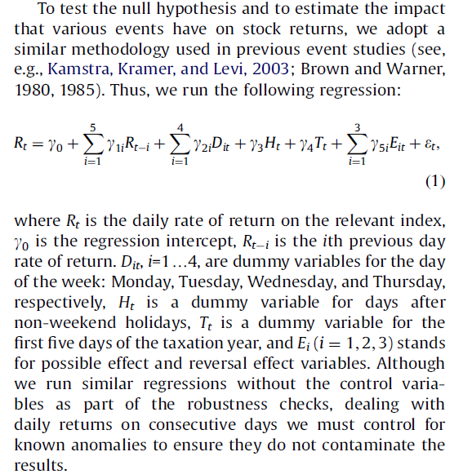
2.2.2 Market level analysis - regression

Slide 31
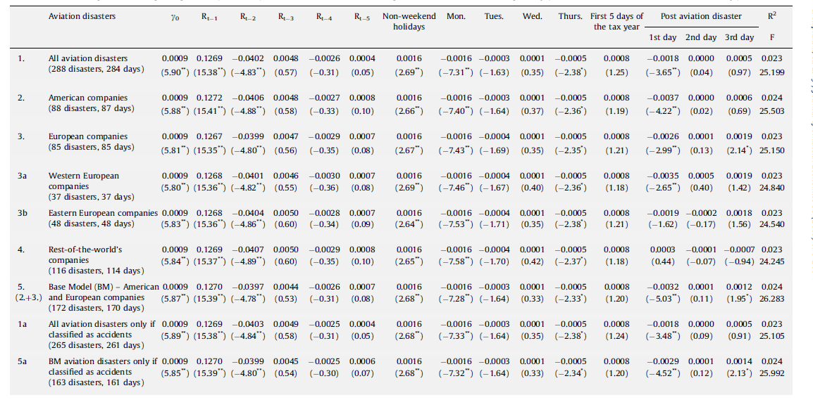
2.2.2 Market level analysis - regression

Slide 32
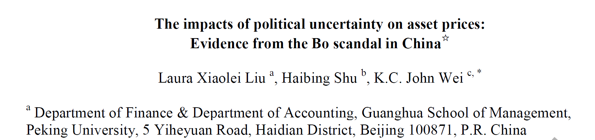
2.3 Firm level analysis

Slide 33
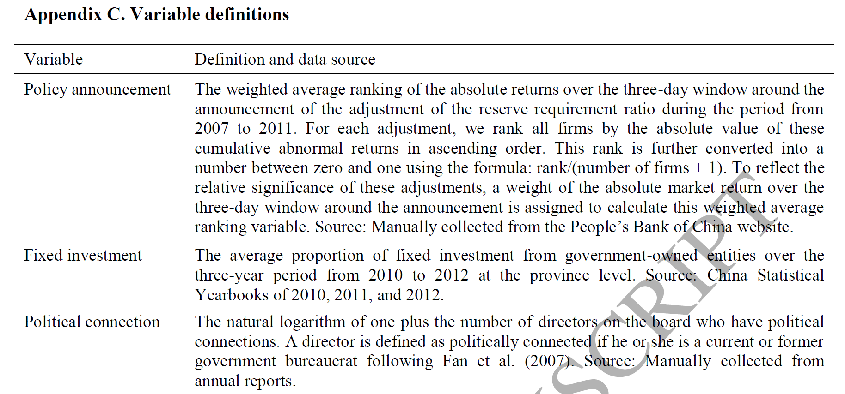
2.3.1 Firm level analysis

Slide 34
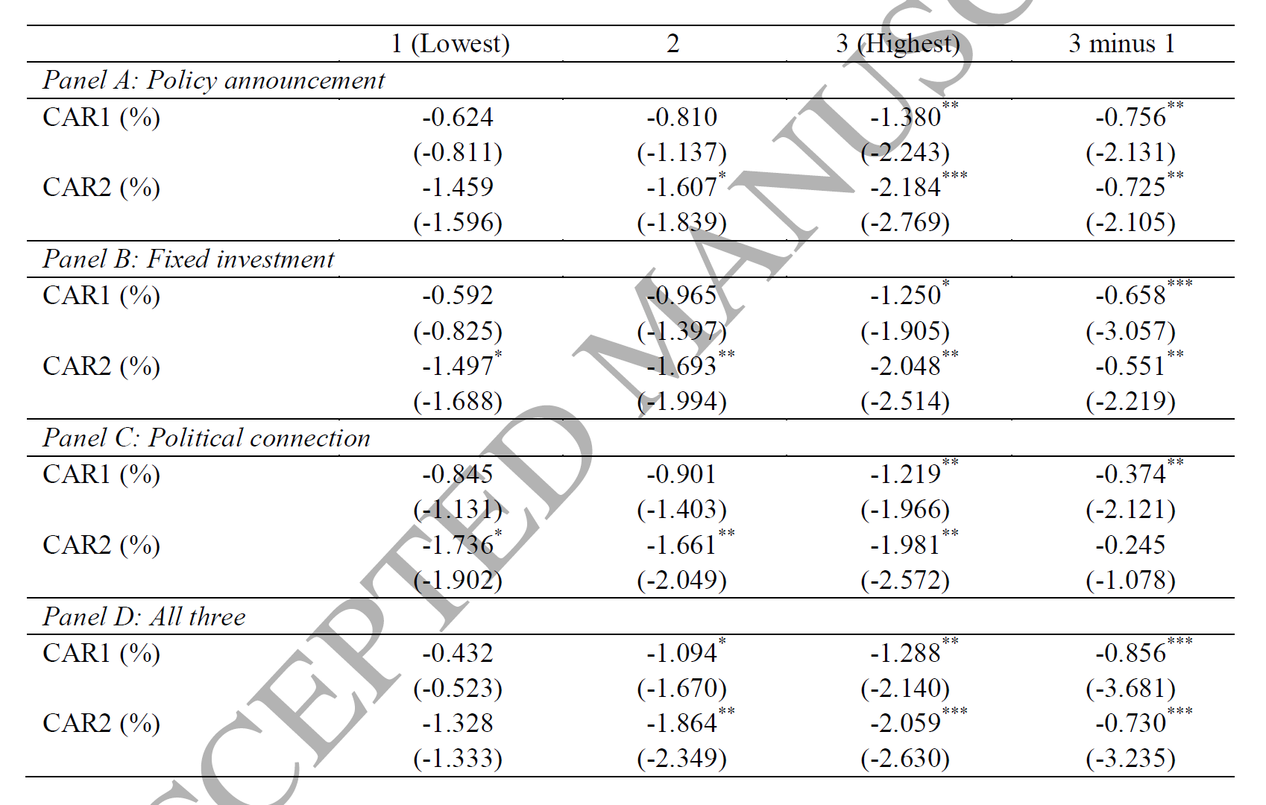
2.3.1 Firm level analysis – t TEST

Slide 35
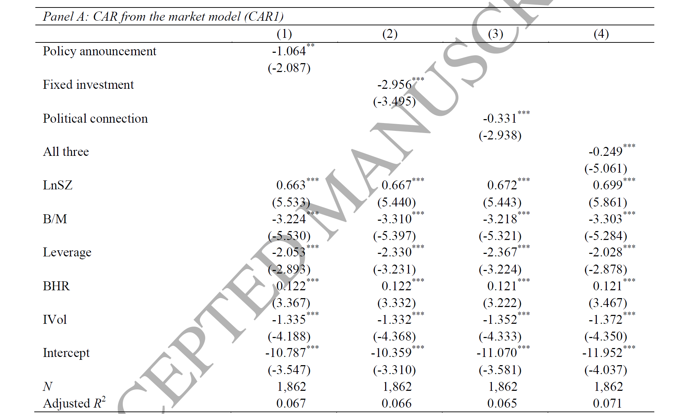
2.3.2 Firm level analysis - regression

Slide 36
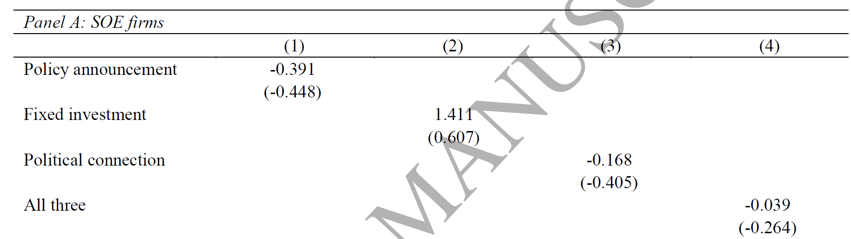
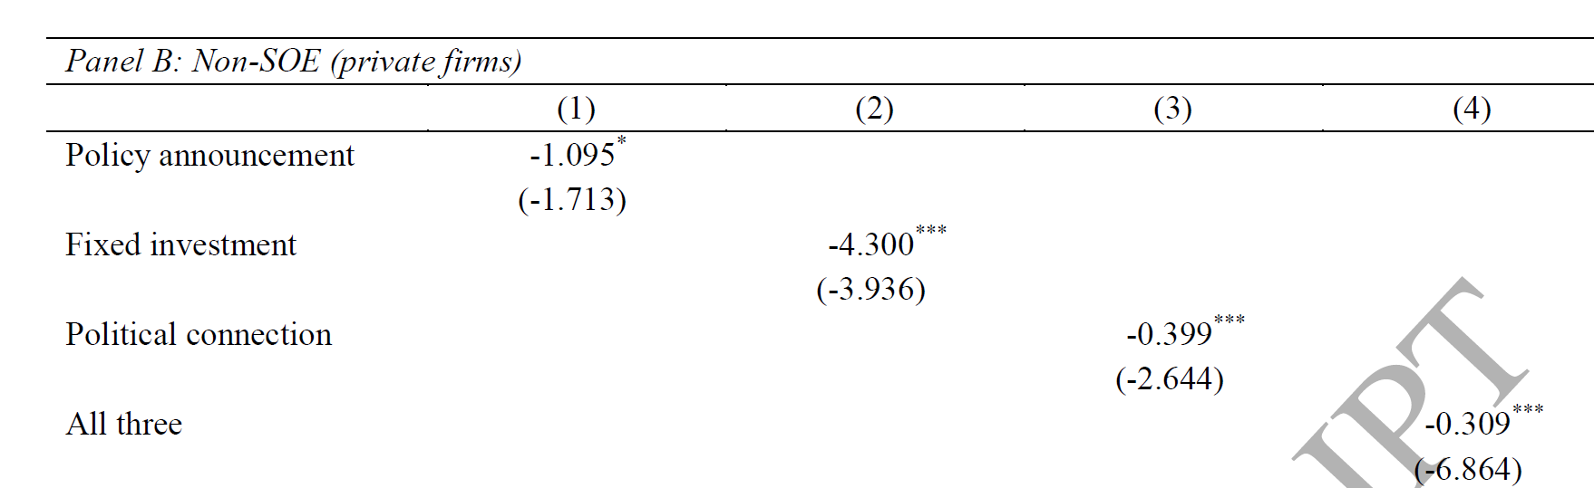
2.3.2 Firm level analysis - Hete

Slide 37
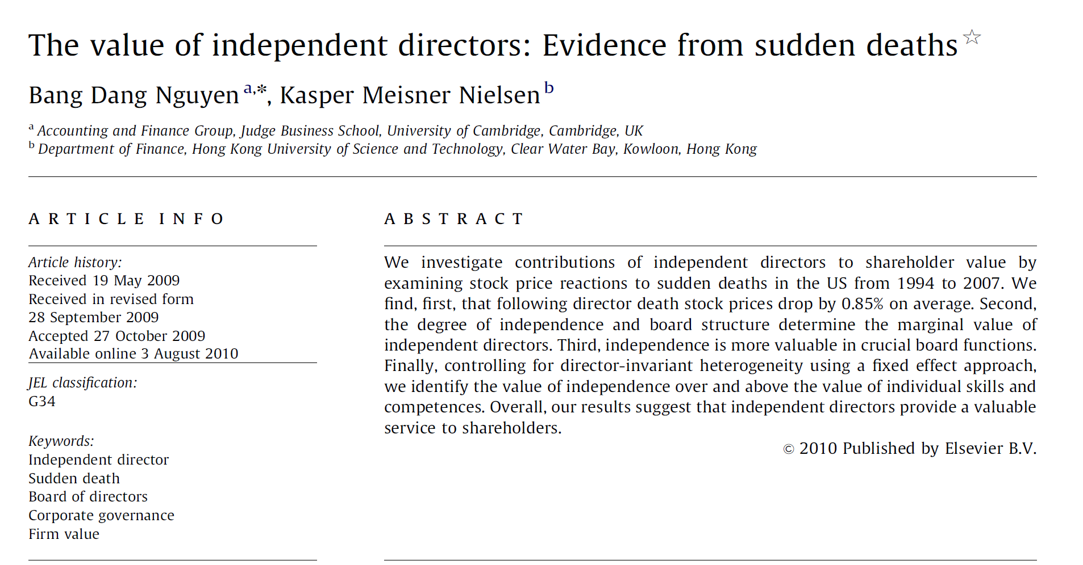
3 With Control Group

Slide 38
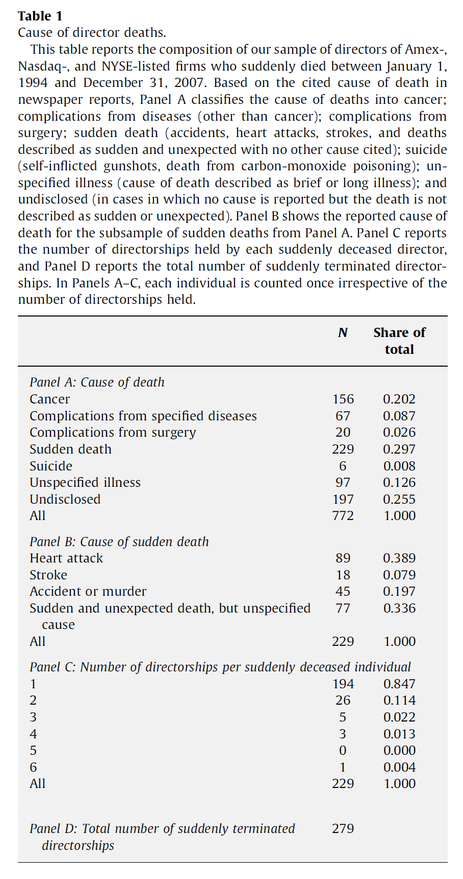
3.1 Firm level Event

Slide 39
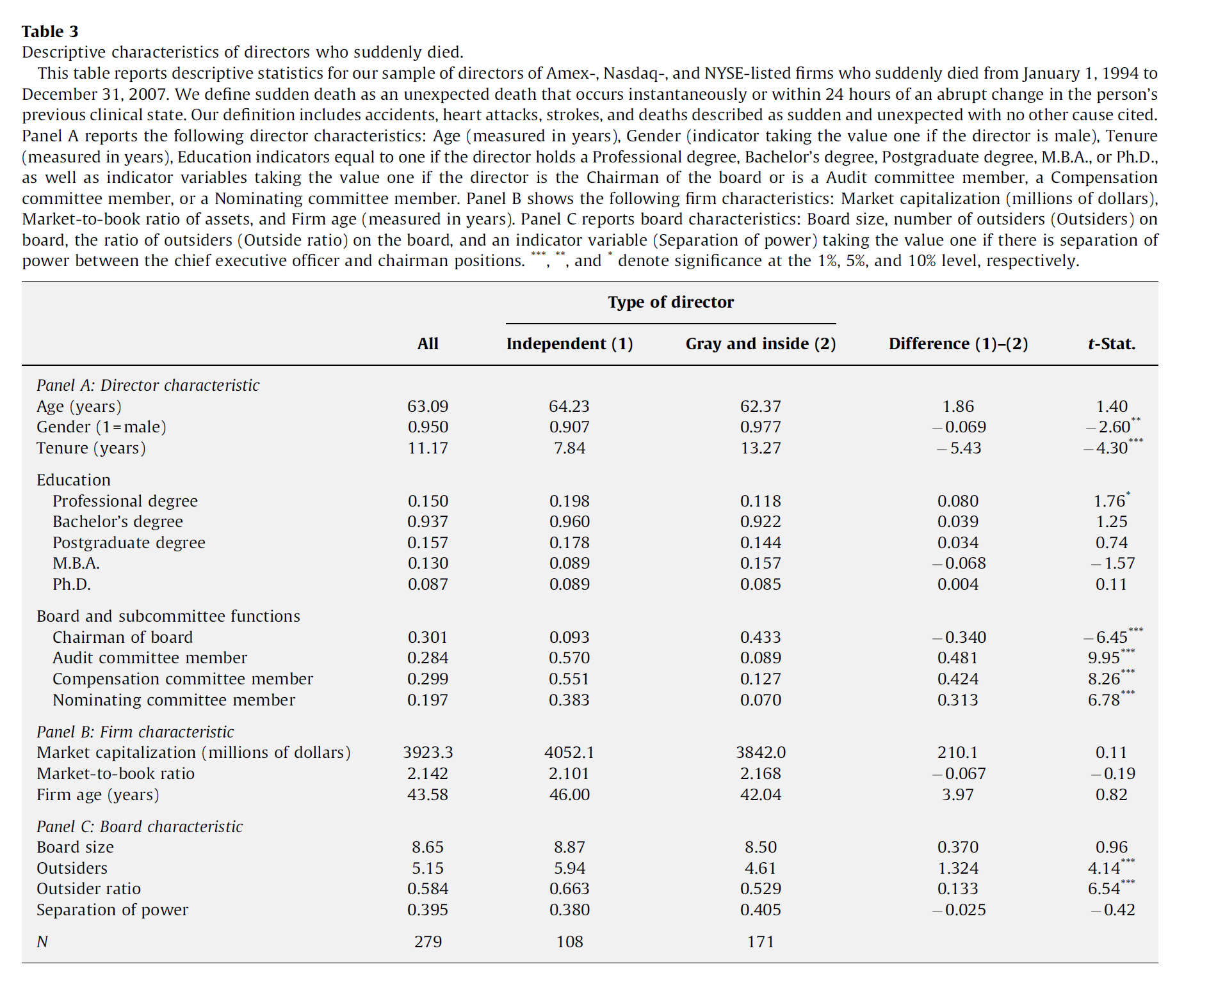
3.2 control vs treated

Slide 40
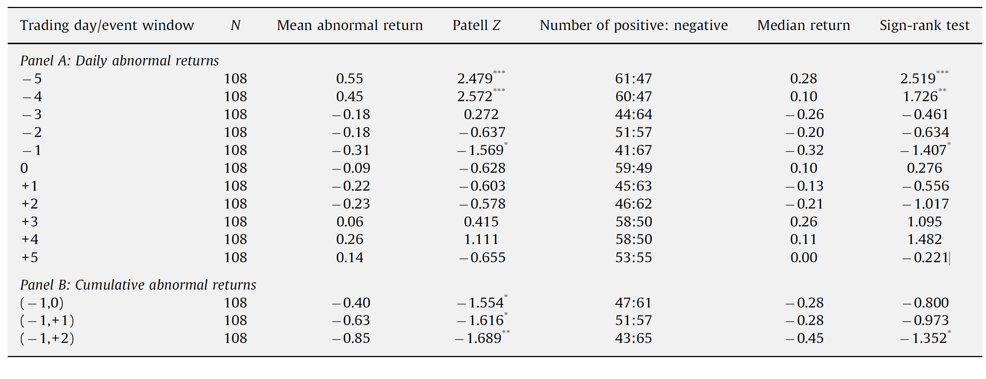
3.3 AR AND CAR

Slide 41
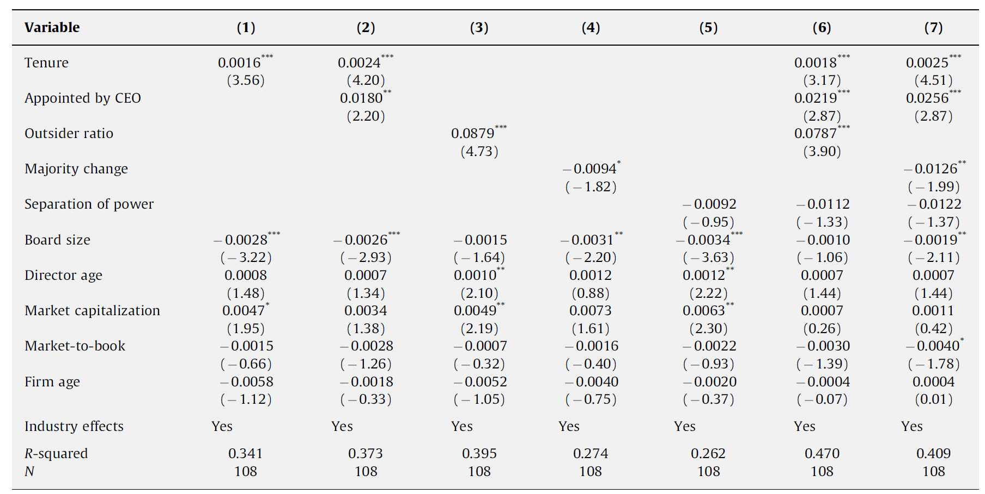
3.4 mechanism analysis - independence

Slide 42
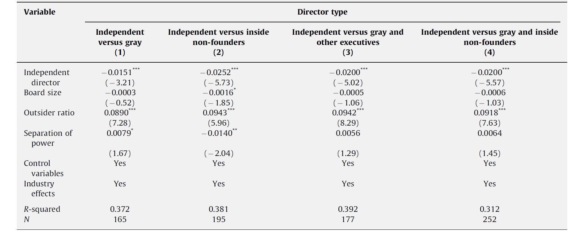
3.5 endogeneity – comparison1

Slide 43
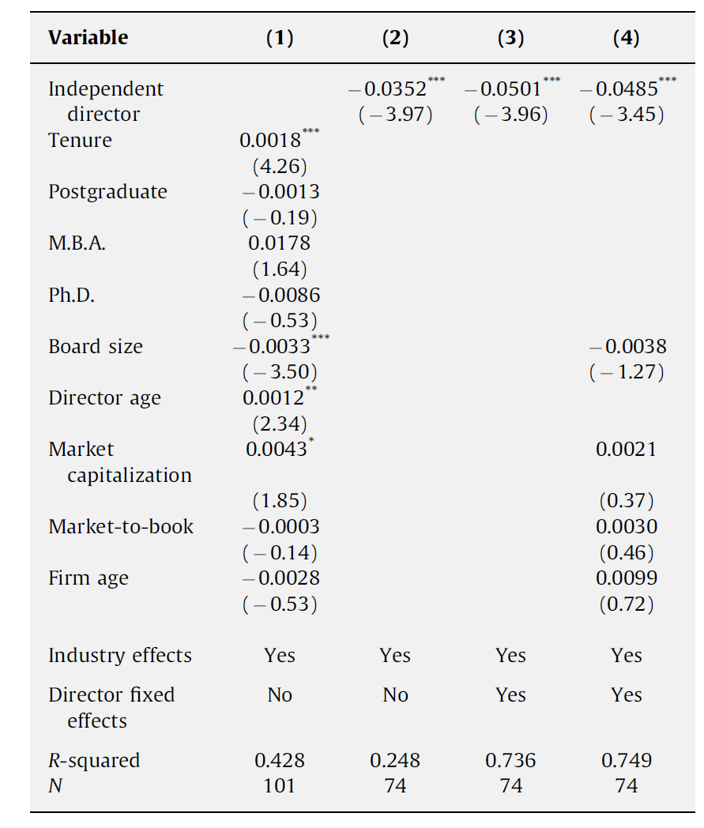
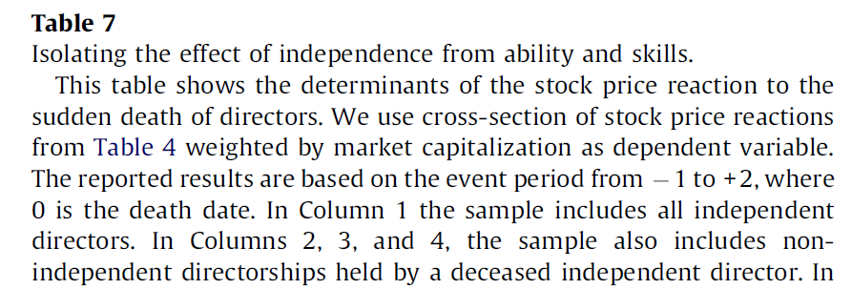
3.5 endogeneity – comparison2

Slide 44
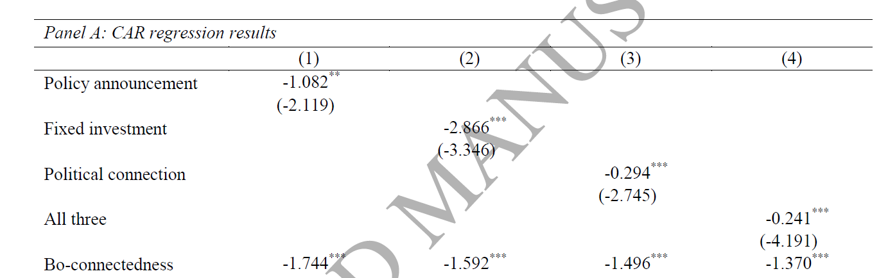
3.7 analysis– comparison Liu(2017)

Slide 45
4 EMH & Behavior Finance
The efficient market hypothesis (EMH), alternatively known as the efficient market theory, is a hypothesis that states that share prices reflect all information and consistent alpha generation is impossible.
According to the EMH, stocks always trade at their fair value on exchanges, making it impossible for investors to purchase undervalued stocks or sell stocks for inflated prices.
Therefore, it should be impossible to outperform the overall market through expert stock selection or market timing, and the only way an investor can obtain higher returns is by purchasing riskier investments.

Slide 46
4 EMH & Behavior Finance
Behavioral finance is the study of the effects of psychology on investors and financial markets. It focuses on explaining why investors often appear to lack self-control, act against their own best interest, and make decisions based on personal biases instead of facts.
Behavioral finance is the study of psychological influences on investors and financial markets. At its core, behavioral finance is about identifying and explaining inefficiency and mispricing in financial markets. It uses experiments and research to demonstrate that humans and financial markets are not always rational, and the decisions they make are often flawed.
Notes:
From Kaplan Financial Education

